Slide 1


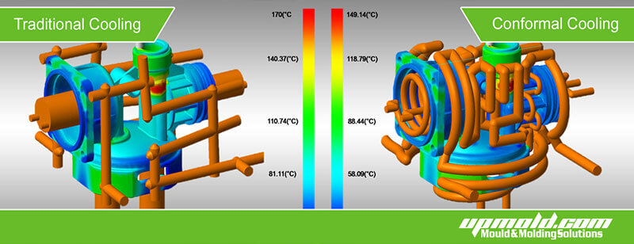

325-MAE Final Presentation Fluids And Complex Systems Research Centre Developing CAD Of Cooling Channels Inside A 3D Printed Mould For A Quality Aluminium Cast
Group 24:
Anshdeep Batta 7548134
Dimosthenis Stratis 8145659
Tsvetomir Pashov 7120158
Yash Mehta 6999791
Supervised by: Dr Erdal Turkbeyler
Notes:
Dimos
Client Presentation 2
Present members and supervisor
The presentation slides will be presented by their authors

Slide 2
Content
Problem description
Solution 1
Solution 2
Final solution selection
Possible application
Conclusion & Future recommendations
Notes:
Dimosthenis Stratis 8145659

Slide 3

Problem Description
The conventional method of making the cooling channel has number of drawbacks like ineffective and non uniform cooling.
Moving forward, a system needs to be developed for automating the process of channel extrusion.
The process involves creating numerous channels and testing the thermal cooling properties of the die itself.
It is done to avoid –
Traditional cooling channels.
Decrease the time taken by the mould part to cool.
Notes:
Yash Mehta 6999791
Conventional cooling channels has its own limitations like non-uniform cooling, limitations in terms of geometry, inconsistent distance from cavity surface.
Help decrease simulation time.
Easy process of channel extrusion.

Slide 4

Aim of the Project
The project aims to create a CAD macro script with the help of visual basics for applications which assists the user to develop a conformal cooling channel in a 3D geometrical part using the CATIA software.
Notes:
Yash Mehta 6999791

Slide 5
Business context of the project
Macro Script
Easy the process of producing mould tools
Convenient to modify conformal cooling channels
Reduce human error
Saves by performing repetitive task
Notes:
Yash Mehta 6999791

Slide 6
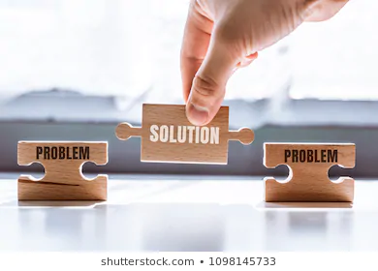
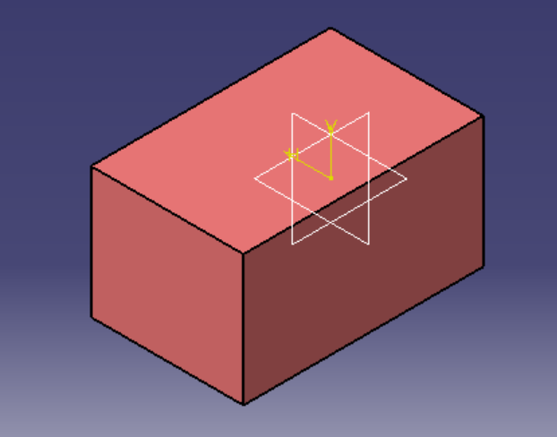
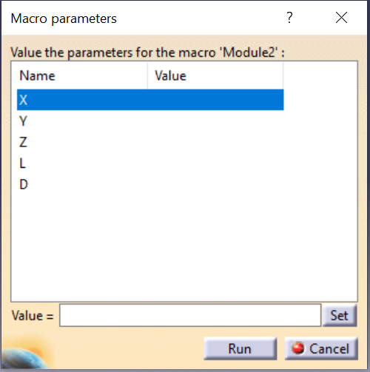
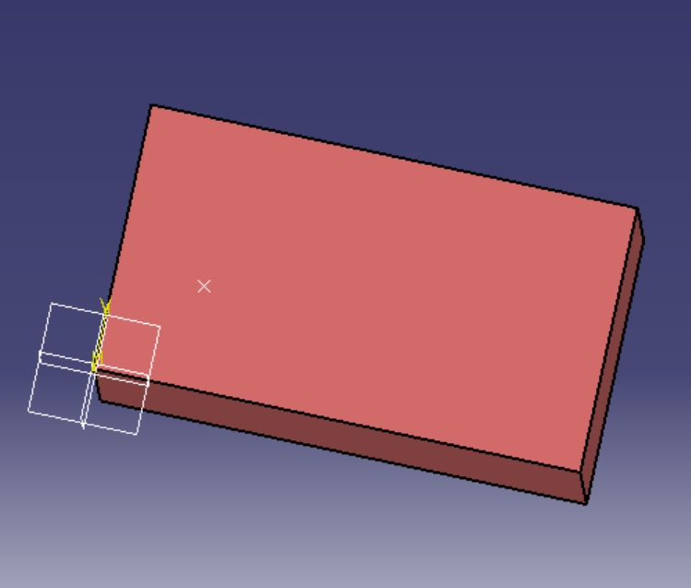
Solution 1:
Notes:
Anshdeep Batta 7548134

Slide 7
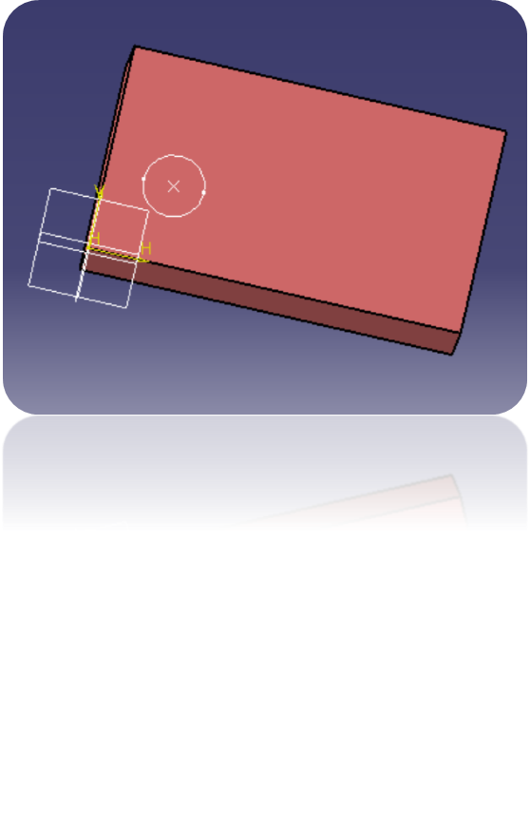
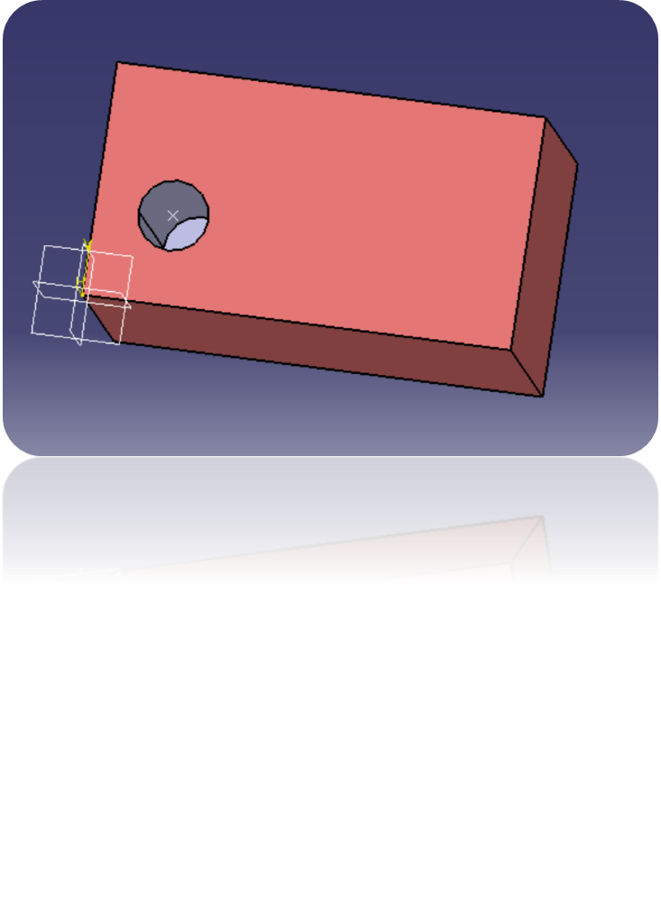
FINAL SOLUTION:
Notes:
Anshdeep Batta 7548134

Slide 8
Limitations of solution 1
Multiple Extrusion Not possible
Can create the channel only when the point is on the surface of the model
Only straight channels can be created
Notes:
Anshdeep Batta 7548134

Slide 9
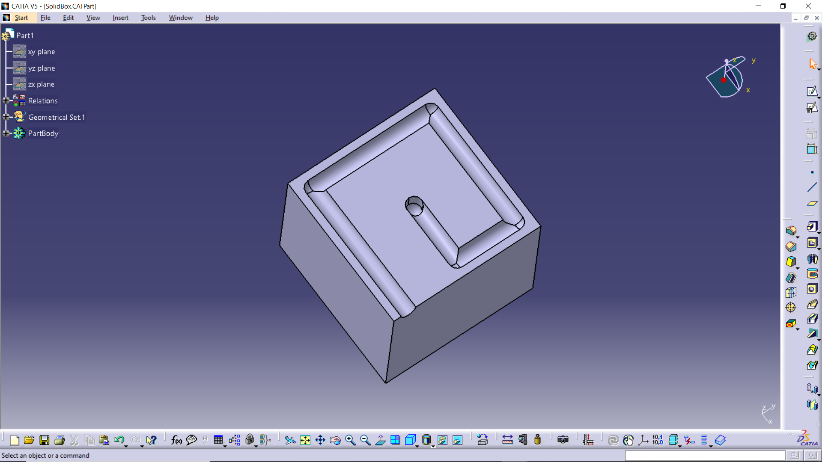
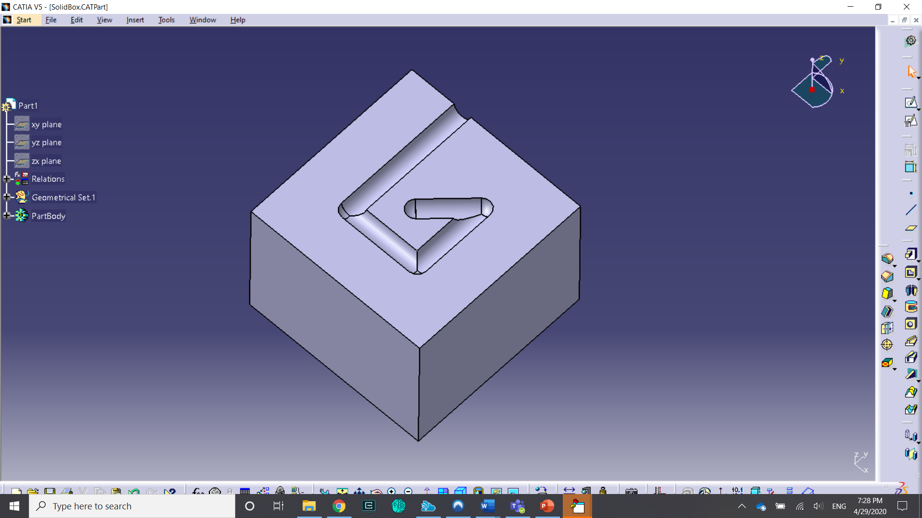
Solution 2
Notes:
Tsvetomir Pashov - 7120158
Solution 2 is based on generating a channel that can be fully inside a solid geometry. It doesn’t require a reference surface from which to start from. The approach that it uses is that it creates its own reference plane at both its start and end.
These figures are an example of what a final internal layout looks like at different thickness levels of the solid geometry.

Slide 10
Pseudocode
Check if there is an open part
Check if there is a selected excel spreadsheet
For every 2 consecutive datasets in the spreadsheet
Calculate plane equations parameters
Generate reference point for 1st dataset
Generate reference point for 2nd dataset
Generate plane for 1st dataset
Generate plane for 2nd dataset
Create a circle on 1st plane
Create a circle on 2nd plane
Remove solid between the circles on 1st and 2nd plane
Remove spherical solid section at both ends of the channel
Next
Notes:
Tsvetomir Pashov – 7120158
Explanation pseudocode
This method was developed because it can be applied for multi channel layout.

Slide 11
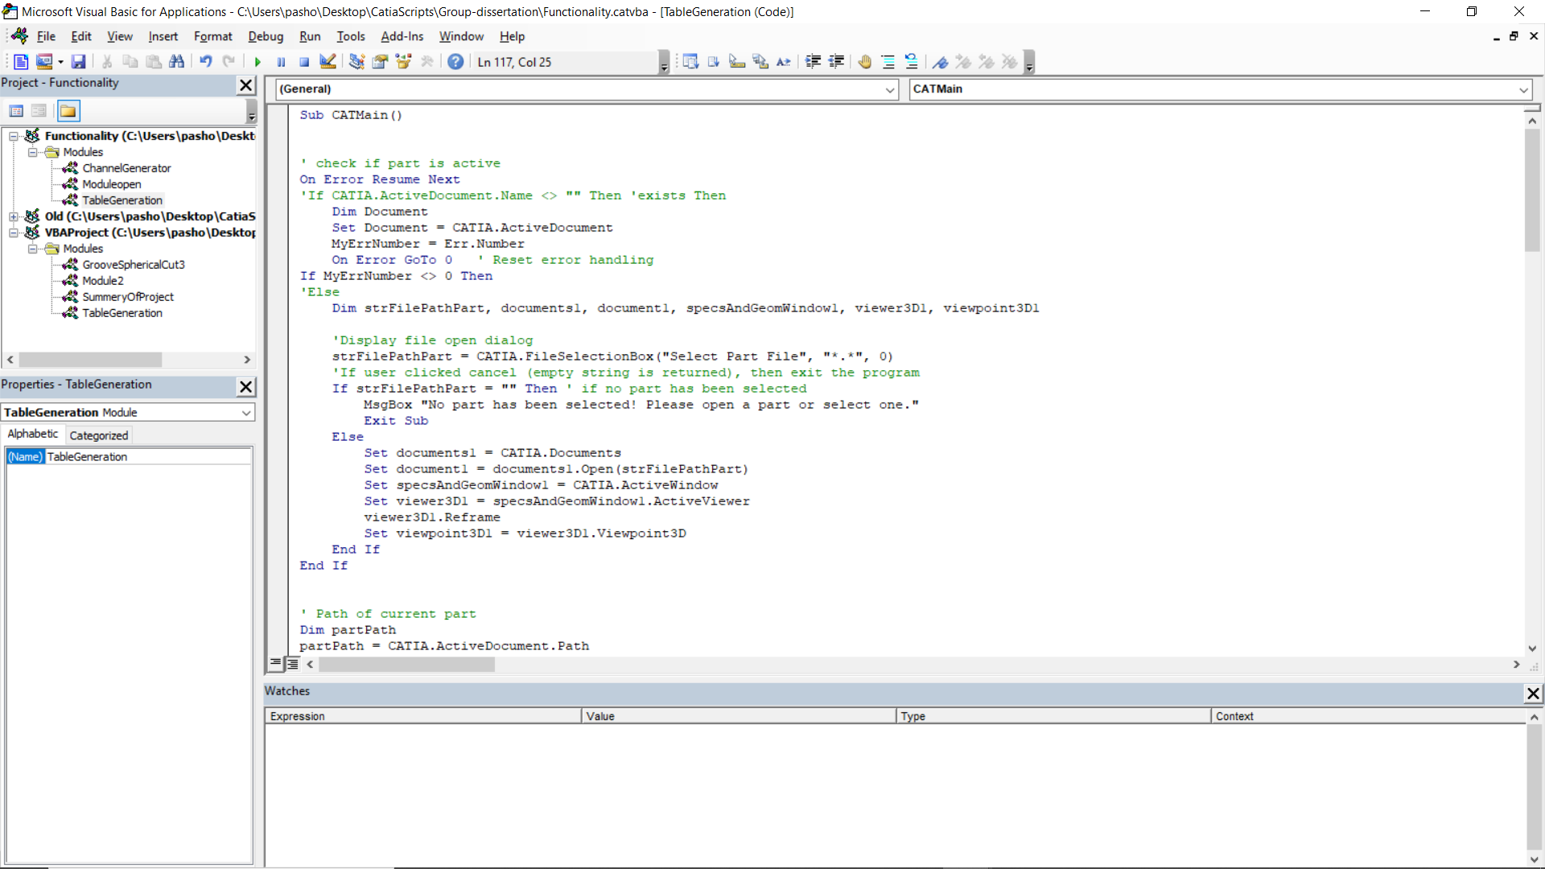
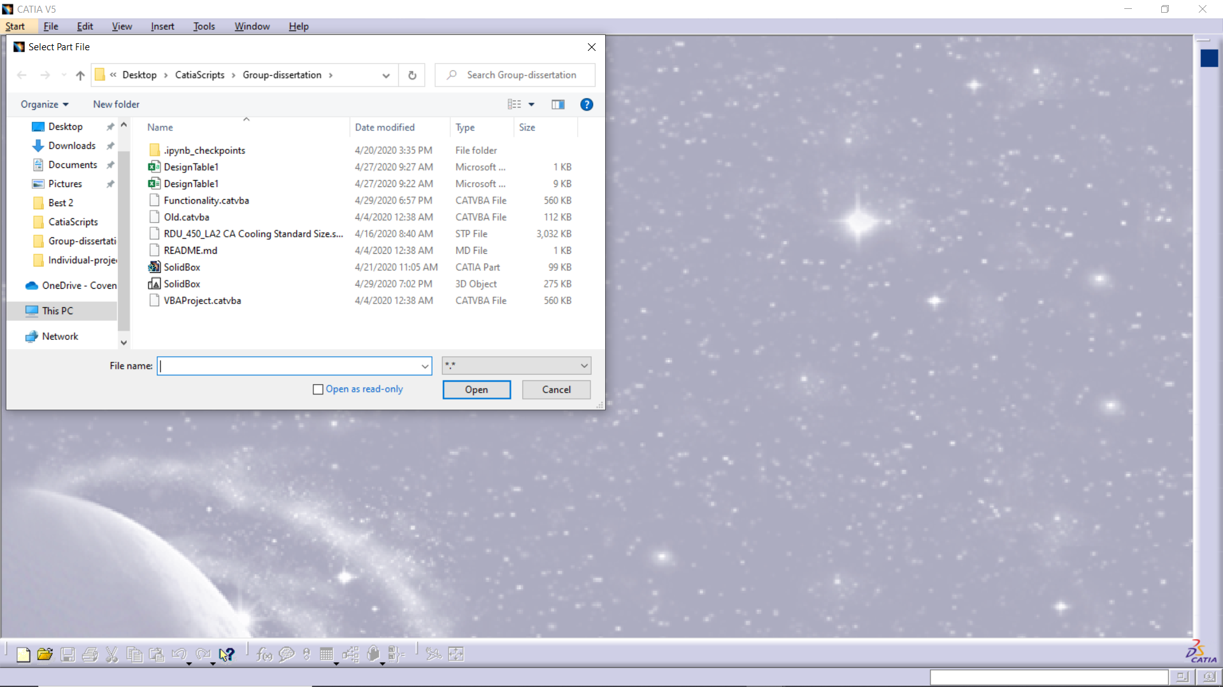
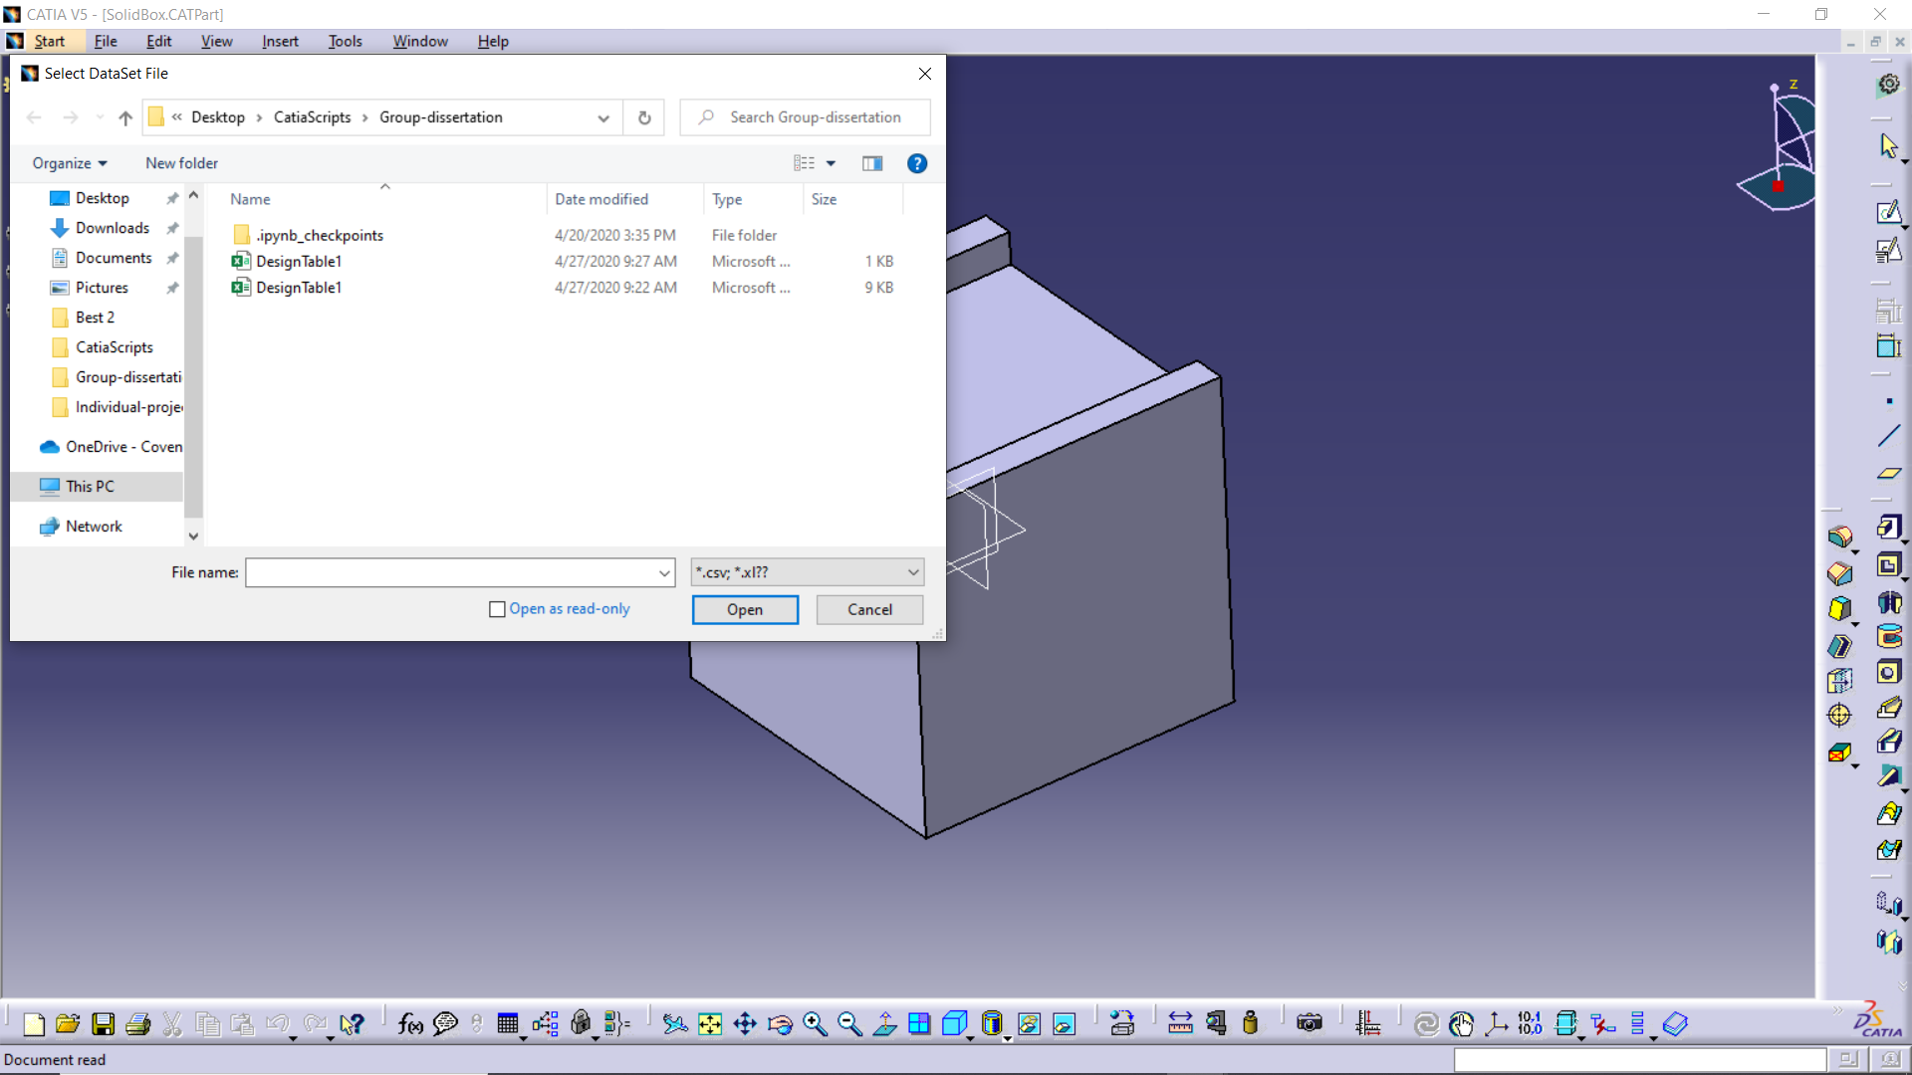
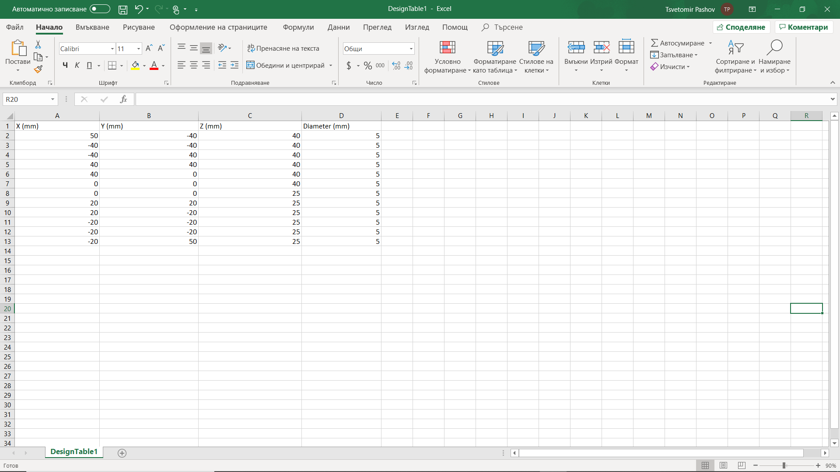
Notes:
Tsvetomir Pashov – 7120158
The macro prompts the user to select first a part that will be edited and second a spreadsheet that contains the positions of the channels.
A example of the expected spreadsheet template can be seen on the bottom right figure.

Slide 12
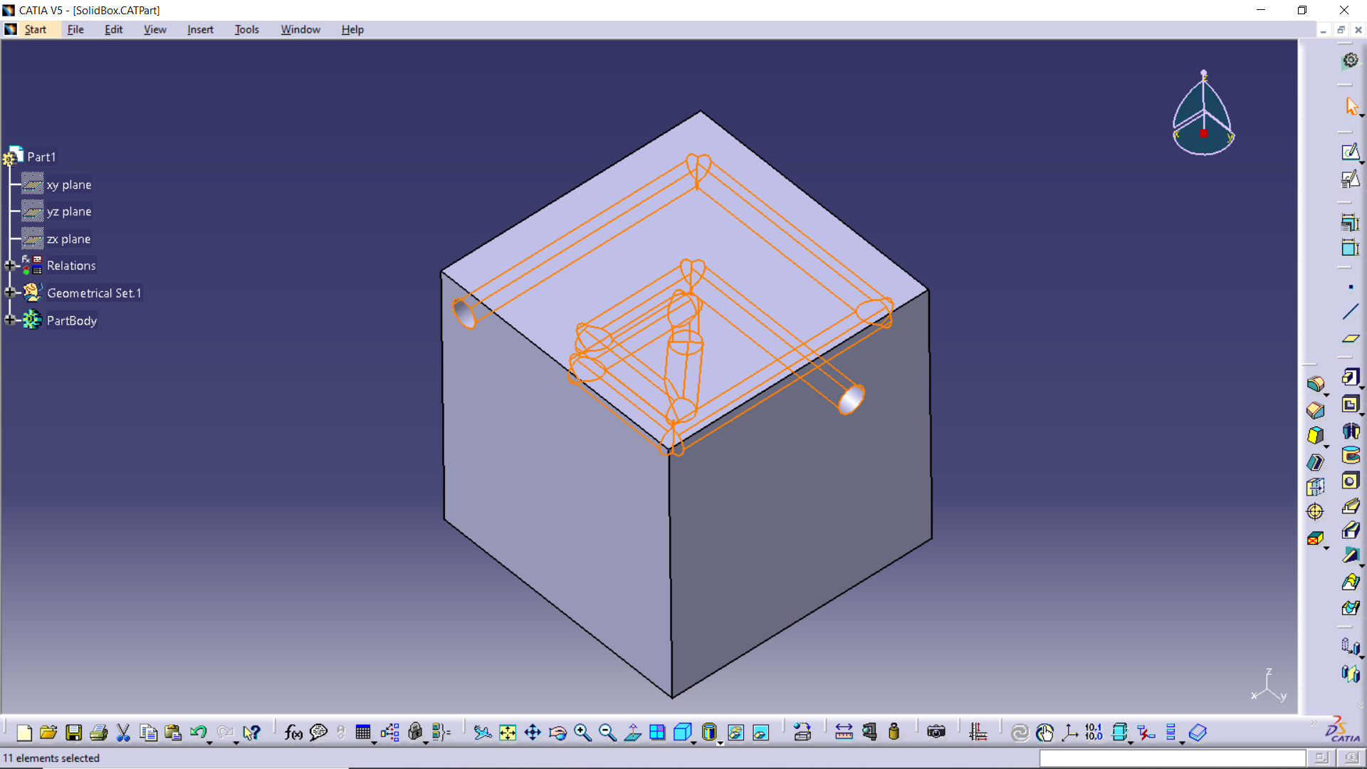
Notes:
Tsvetomir Pashov – 7120158
The executed macro leads to the generation of the inner layout specified in the spreadsheet
The top 2 pictures represent a top view of a cross sectional cut on 2 different levels.
On the left is a 40 mm case which is the first vertical level at which channels are created.
And on the right at 25 mm which is the second vertical level at which the remaining channel of the layout are created.
The bottom figure highlights the created inner layout.
The limitations of this solutions are that it doesn’t incorporate conformal technique and if two channels have either the starting or ending point the spherical link returns an error.

Slide 13
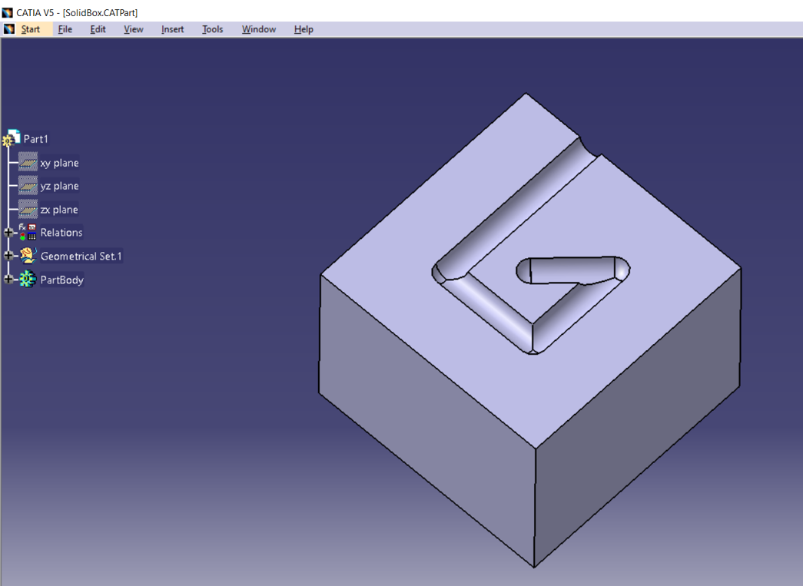
Solutions Comparison
Solution 1 | Solution 2
User friendly environment parameter box | Command inside codes need to be edited to change parameters
Extrusion of channel on the face of model | Extrusion of channel inside the model
Does not use new plane for new point | Use of multiple planes for new point
Increased time for multiple channels | Time efficient for multiple channels
Notes:
Dimosthenis Stratis 8145659
Solution 1 has a more user-friendly environment as it uses a parameter box which makes it simpler for inserting values of x, y and z coordinates and the channel diameter whereas in solution 2 you need to open the command window and insert the values by changing the code parameters.
Solution 1 can only extrude a channel on the external surface of the CAD model whereas solution 2 can extrude channel inside the geometry
Solution 1 does not use new plane each time a new point is created whereas 2 uses the approach of using a plane equation to generate a plane each time a new point is created .
For multiple extrusions solution 1 is more time consuming as only one extrusion is allowed for each time thus same process has to be repeated for multiple times in contrast in solution 2 all the points are been given in once and later the channel is created by using the plane equation.
After comparing both the solutions, it was concluded that Solution 2 is the most suitable for this project. Due to limited time during the global pandemic and lack of resources, it was difficult to include the certain steps from Solution 1 into solution 2 to optimize the final solution reaching all the aims and objectives of this project.

Slide 14
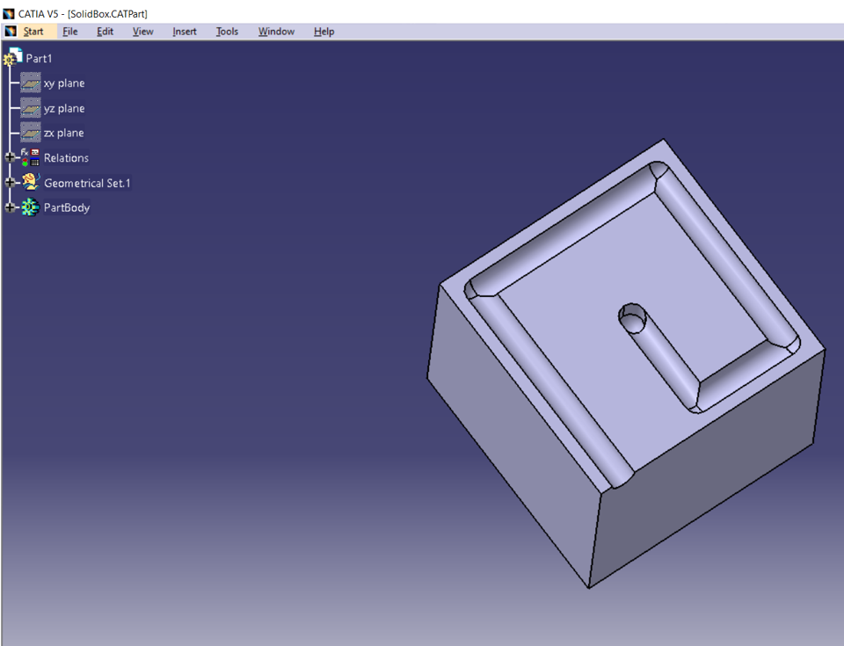
Final Solution
Creation of a pseudocode
X ,Y and Z coordination
Channel diameter
Generate a plane
Remove material following created path line
Notes:
Dimosthenis Stratis 8145659
The current state of the project does not meet all the objectives. Those objectives are the missing GUI that could have been ignored if the application could be ran from python. The reason for that is that the client is using python as the main tool for the CFD simulations and data extraction. Unfortunately, that information was shared at a later stage of the project where changes from CATIA macro to python were not assigned and inefficient in terms of the project delivery date.
As state above the application is not fully meeting the clients’ standards and hence needs some improvements such as:
Call the code from python and remove the need of the assembly method
Extract the conformal surface points and use them to call the channel generation method, with 2 dataset inputs at a time

Slide 15
Possible Applications
Automotive Industry
Casting Drawings
Aerospace Industry
Casting Drawings
Food Industry
Water Bottles
Civil Engineering
Architecture drawings
Lego
Notes:
Dimosthenis Stratis 8145659

Slide 16
Conclusion and future recommendation
Created a GUI using for single channel Extrusion
Pseudocode to create single and multiple extrusion channel.
User friendly script and time efficient.
Both the Solutions can be linked with Python.
Numerous possible application
Notes:
Yash Mehta 6999791

Slide 17
Thank You.

